Slide 1
Shortest Paths Algorithms Exercises
BFS
Dijkstra’s Algorithm
Bellman-Ford Algorithm
Lecture 5.1, Spring 2026
Notes:
Welcome to week 2
Finally, we get to build a routing protocol. Today will be entirely focused on Distance-Vector approach and then we’ll talk about an alternative approach hopefully tomorrow.
so we're going to number them 1 through seven we'll come up with rules and when you put the seven rules together you get
29:30
an algorithm called the distance Vector protocol and it allows us to find shortest paths through the entire
29:36
network

Slide 2
Q. Dijkstra’s Algorithm
Exam question: Given this directed graph, run Dijkstra’s Algo to find shortest paths starting from source node A. Give the node visit order, and fill in this table of SN (Shortest Distance) and PN (Previous Node), crossing out old SD and PN as you find a shortcut path with smaller SD
Visit Order
Node | SD | PN
A
B
C
D
E
F
G
start
2
B
A
1
1
5
2
E
1
1
D
C
5
3
2
6
G
10
F

Slide 3
Q. Dijkstra’s Algorithm (Source Node S)
ANS
ANS
A
A
2
Node | SD | PN
S | 0 | /
A
B
2
Node | SD | PN
S | 0 | /
A
B
S
S
1
3
4
4
B
B
ANS
ANS
A
A
Node | SD | PN
S | 0 | /
A
B
2
Node | SD | PN
S | 0 | /
A
B
2
S
S
1
1
4
4
B
B
3
Notes:
SD: Shortest Distance. PN: Previous Node

Slide 4
Q. Dijkstra’s Algorithm (Source Node A, Undirected Graph)
3
B
D
3
1
A
1
2
Node | SD | PN
A
B
C
D
E
1
C
E
4
Visit Order
4
Notes:
David Kauchak
cs161
Summer 2009
Graphs: MSTs and Shortest Paths https://cs.pomona.edu/~dkauchak/classes/algorithms/

Slide 5
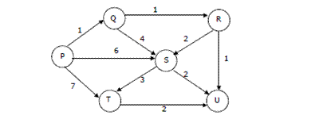
Q. Dijkstra’s Algorithm (Source Node P, Directed Graph)

Slide 6
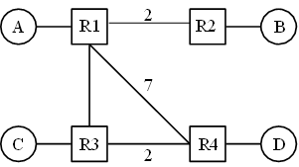
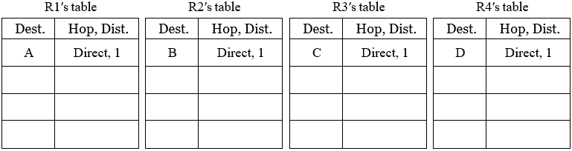
Q. Distance-Vector
Consider running the distance-vector protocol on the topology below. Unlabeled links have cost 1. Fill in the routing tables based on Distance-Vector algorithm. (refer to the handout for details.)

Slide 7
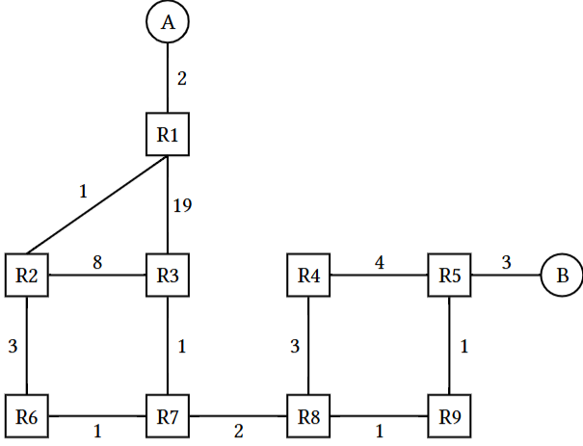
Q. Link-State Routing
Refer to the handout for details.

Slide 8
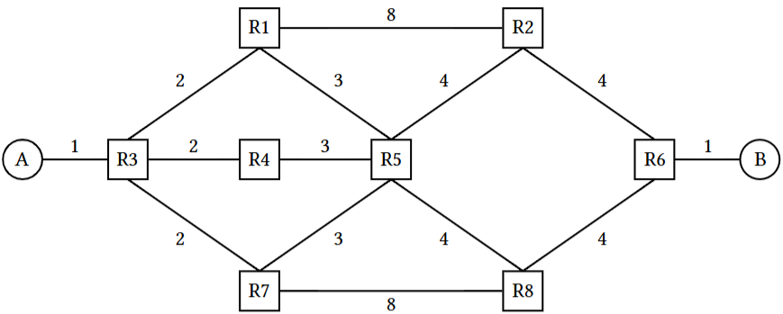
Q. More L3 Link State
Refer to the handout for details.

